Slide 1



Desafio Cadastro Positivo PJ
Equipe Rocket

Slide 2


Slide 3


Slide 4
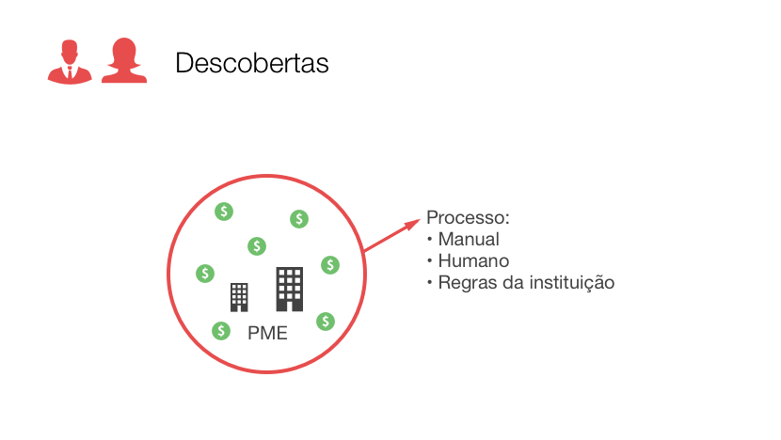

Slide 5
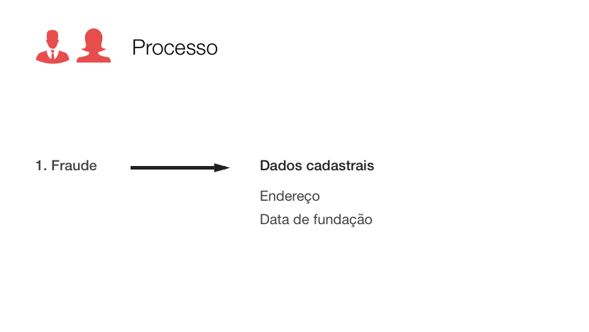

Slide 6
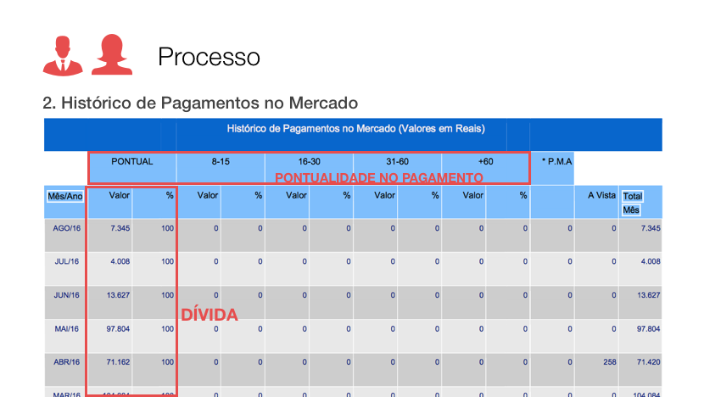

Slide 7
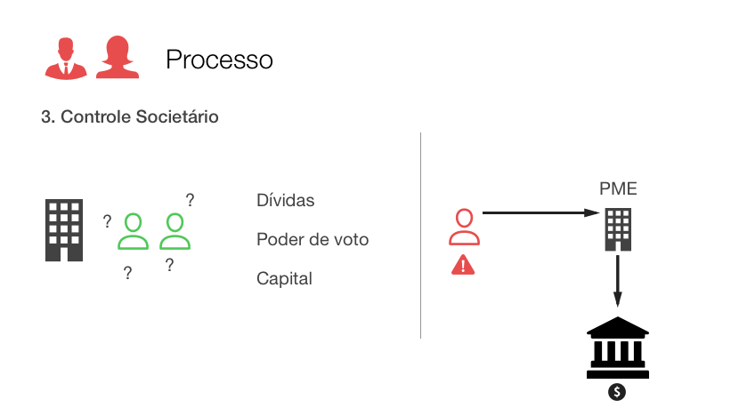

Slide 8
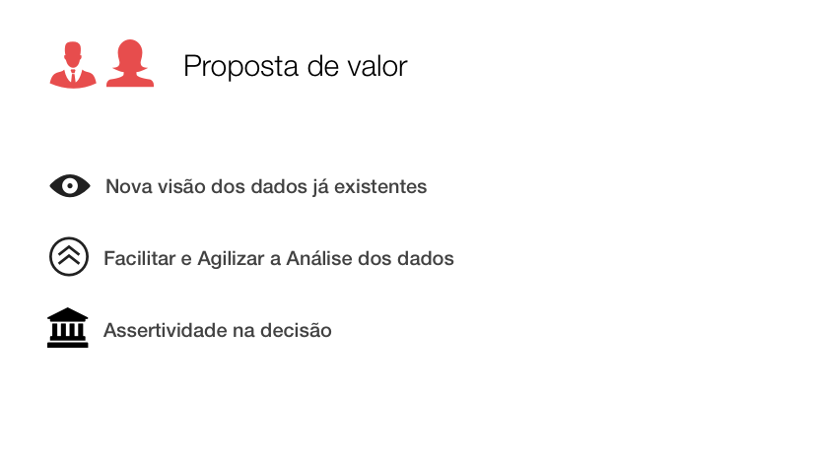

Slide 9



Demo
READY, STEADY, GO!
https://s3.amazonaws.com/team-rocket-serasa/index.html
http://bit.ly/2pke8Vz

Slide 10


